Slide 1
Building a Diamond Price Prediction Model
Xan Lamoreux
Professor Dr. Shanker
Fundamentals of Machine Learning (MIS-64060-002)
5 December 2021

Slide 2
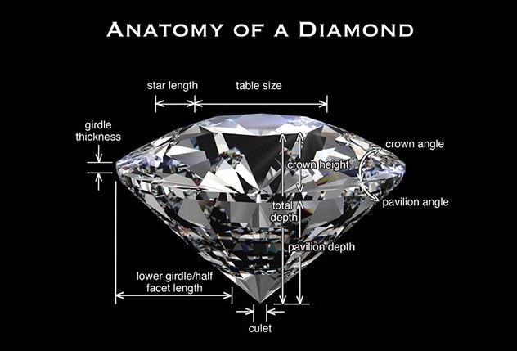
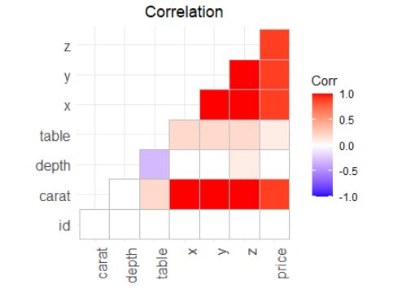
The goal of this project is to predict the price of diamonds based on their characteristics.
Every diamond is unique – but each is able to be measured.
What variables are mostly related to the price?

Slide 3

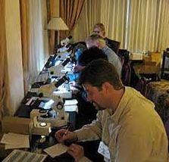
The Problem: Each step is manual including the math!
The gemologist views every angle of the diamond...
… and writes everything down to be hand calculated!

Slide 4
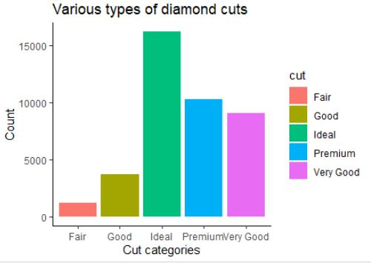
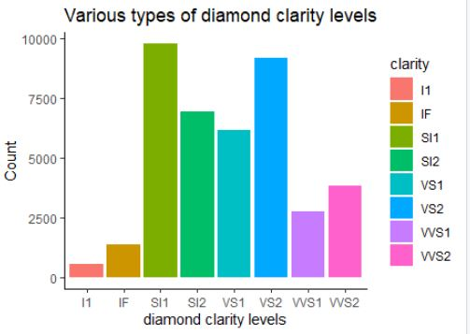
The Approach: Use data which has captured many combinations of variable measurements to calculate and predict the price.
View of diamond cut data
View of diamond clarity data

Slide 5
EUREKA! The Results of the prediction model come to 91.37% accurate.
Discovery
Price is most determined by carat weight, length, width, and depth.
We discover that variables x, y, and z - along with carat weight - have the greatest impact on the price of a diamond.
x: length in mm
y: width in mm
z: depth in mm

